Slide 1
Dental Anesthesiology: Standard of Care and Liability
Dr. Sean G. Boynes
Director of Interprofessional Practice
DentaQuest Institute

Slide 2
Role of the Dentist in Anesthesia / Sedation Care
In the overwhelming majority of jurisdictions, whether you are providing the sedation care or have itinerant services you are responsible for the anesthesia care.

Slide 3
Informed Consent
Analgesia / Anxiolysis / Sedation
Much more extensive
Should be separate consent
Require additional signature
Assent should be obtained for minors

Slide 4
Informed Consent
It is a process of communication between a patient and physician that results in the patient's authorization or agreement to undergo a specific dental and/or medical intervention.
Your patient should have an opportunity to ask questions to elicit a better understanding of the treatment or procedure, so that he or she can make an informed decision to proceed or to refuse a particular course of medical intervention.

Slide 5
Informed Consent
According to AMA and ADA:
In the communications process, you, as the dentist / physician providing or performing the treatment and/or procedure (not a delegated representative), should disclose and discuss with your patient:
The patient's diagnosis, if known;
The nature and purpose of a proposed treatment or procedure;
The risks and benefits of a proposed treatment or procedure;
Alternatives (regardless of their cost or the extent to which the treatment options are covered by health insurance);
The risks and benefits of the alternative treatment or procedure; and
The risks and benefits of not receiving or undergoing a treatment or procedure.
http://www.ama-assn.org/ama/pub/physician-resources/legal-topics/patient-physician-relationship-topics/informed-consent.shtml

Slide 6
Informed Consent
Complications may occur:
“I have been informed and understand that occasionally there are complications of the drugs and anesthesia including, but not limited to : pain, hematoma, phlebitis, permanent or temporary numbness, infection, swelling, bleeding, discoloration, nausea and vomiting, allergic reactions, fluctuations in breathing, heart rhythm, and/or blood pressure, cardiac arrest, brain damage, coma, and death, I further understand and accept the risk that complications may require hospitalization.”

Slide 7
Informed Consent
Pregnancy and Expecting Mother
“I understand that anesthetic drugs may be harmful to the unborn child and may cause birth defects or spontaneous abortion. Recognizing these risks, I accept full responsibility for informing the dental provider or anesthesiologist of a suspected or confirmed pregnancy with the understanding that this may necessitate the postponement of the anesthetic. For the same reasons, I understand that I must inform the anesthesiologist if I am a nursing mother.”

Slide 8
Informed Consent
Explain ALL alternative treatments
Acknowledgement by patient that they had the opportunity and ability to ask questions and that those questions were answered appropriately and effectively
Sign all consents, initial and date where appropriate

Slide 9
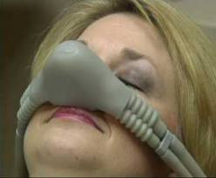
Standard of Care Nitrous Oxide Analgesia

Slide 10
Duties of Dentists who are Nitrous Permit Holders
Prior to the administration of nitrous oxide/oxygen analgesia, the provider takes or updates a patient medical history and gives the patient a physical evaluation sufficient to determine the patient’s suitability to receive nitrous oxide/oxygen analgesia.
Vitals (including weight)
ASA Status

Slide 11
Duties of Dentists who are Nitrous Permit Holders
The dental office in which the permit-holder administers nitrous oxide/oxygen analgesia on an outpatient basis contains the following:
An operating room.
An operating table or chair.
A lighting system.
Dental office suction equipment.
Oxygen and supplemental gas delivery systems, including primary and back-up sources and a fail-safe control mechanism.
A sterilization area.
A gas storage area and scavenger system.
Communications equipment.
Monitoring equipment, procedures and documentation to conform to the age, size and condition of the patient and the AAOMS Manual and AAOMS Guidelines for adult and pediatric patients (OMS), the ADA Guidelines for adult patients (general dentists) and the AAPD Guidelines for pediatric patients (general dentists).
Results of patient medical history, patient physical evaluation and identification of the nitrous oxide/oxygen analgesia procedure to be utilized, prior to the administration of nitrous oxide/oxygen analgesia.
Signed, written, informed patient consent, prior to the administration of nitrous oxide/oxygen analgesia, which includes a description of the procedure, its risks and possible alternative treatments. Consent for a minor patient shall be obtained from the minor’s parent or guardian.
Stethoscope.

Slide 12
Duties of Dentists who are Nitrous Permit Holders
Nitrous oxide/oxygen analgesia is administered to adult and pediatric patients in accordance with the AAOMS Guidelines and AAOMS Manual (OMS) or to adult patients in accordance with the ADA Guidelines (general dentists) or to pediatric patients in accordance with the AAPD Guidelines (general dentists). Conflicts between the AAOMS Guidelines, the AAOMS Manual, the ADA Guidelines or the AAPD Guidelines and this subchapter shall be resolved in favor of this subchapter.
Monitoring equipment and equipment used to administer nitrous oxide/oxygen analgesia is installed, maintained and calibrated according to the equipment manufacturer’s guidelines, contains a fail-safe system and is in proper working condition prior to the administration of nitrous oxide/oxygen analgesia.
Patient records are prepared, maintained and retained in accordance with the Dental Code.

Slide 13
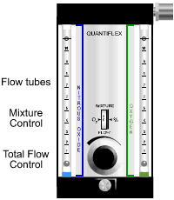
Nitrous Oxide Calibration
As time progresses during the life of a flowmeter, the performance will degrade slowly, over time, until the flowmeter in question is no longer reading correctly.

Slide 14
Nitrous Oxide Calibration
The reasons for a flowmeter falling out of calibration are many and varied:
Deposits in the flowmeter: minerals, oils, solvents and other foreign matter can have a dramatic impact on your meters performance.
Aging: Internal parts of any mechanical object will eventually fail or break, many times the bearings are the cause.
Damage: A flowmeter that has received a substantial impact or has been dropped can change the performance output of a flowmeter.
Improper Installation: Many times, a flowmeter is put out of calibration simply because it was installed improperly. By not following the manufacturers specifications, you can break the meter instantly.

Slide 15
Nitrous Oxide Calibration
If you're setting up a schedule for calibration, a simple rule of thumb is to have your flow meters calibrated once per year. If you're using a new meter or one that's in an unfamiliar environment, it is recommend that initially you calibrate every 6 months until an accurate "footprint" of the meter is represented (usually in the first year) , then switch back to yearly.
Newer models that are assembled and verified by service personnel carry a longer period of time until next calibration

Slide 16
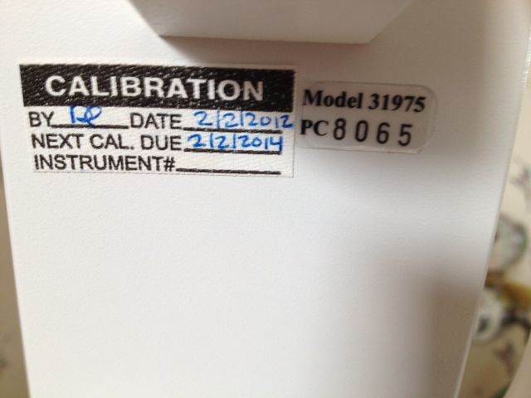
Calibration Tag

Slide 17
Nitrous Oxide Calibration
Integrated Service Solutions
www.integratedservicesolutions.com
Omega Calibration
http://www.omega.com/cservice/isection/index.html
Notes:
Always can go with guidance from vendor of purchase

Slide 18
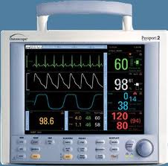
Charting and Documentation

Slide 19
Charting and Documentation
Most common issue with litigation involving dentistry related anesthesia/sedation
Inadequate, inappropriate, and incomplete charting most common reason for settlement / plea deals
Need to understand the necessary monitoring

Slide 20
Documentation
The providers most important aspect within the medico-legal environment
Documentation = Proof
Ideal
EHR
Clinical note completed within 24-72 hours

Slide 21
Monitoring / Charting
Equipment/Charting regulations differ from jurisdiction to jurisdiction.
Each Board sets forth their own regulations
Ideal v. Required v. Recommended

Slide 22
Monitoring / Charting
Ideal (Required for Moderate – Deep Sedation)
Every Five Minutes
Pre-Anes Eval; Baseline Vital Signs; Pre-Med; ID’d; Equipment; etc… (AAOMS Manual)
BP (MAP)
HR (ECG - 5 Lead*)
RR (Capnography); [Pre-chordial] Stethoscope)
Pulse Oximetry
Temperature
EEG (BIS Monitoring)*
*Recommended

Slide 23
Monitoring / Charting (N2O)
AAOMS
Recommended
Every Five Minutes
BP
HR
RR [Every 15 Minutes]
Pulse Oximetry Recording

Slide 24
Monitoring / Charting (N2O)
ADA Recommendations
Approximately Every 10 minutes
BP
HR
RR
Brief Description of Patient Condition
Cooperation
Comfort
Complications

Slide 25
Monitoring / Charting (N2O)
Some state specific requirements (Maryland, South Dakota, etc)
Approximately every 15 minutes
HR
BP
RR
Recommended – Pulse Oximetry

Slide 26
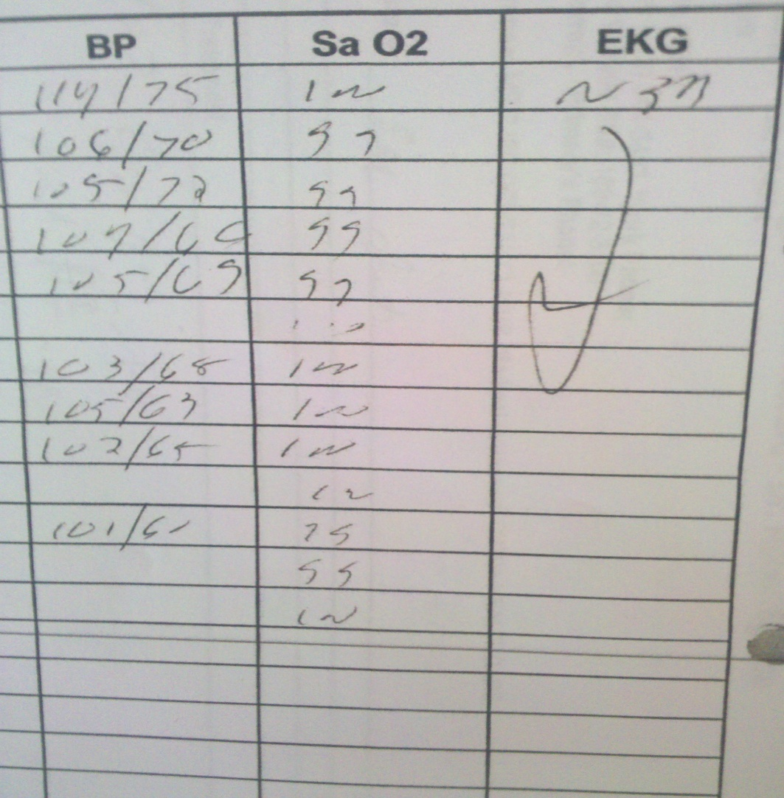
Monitoring / Charting: Case Review

Slide 27
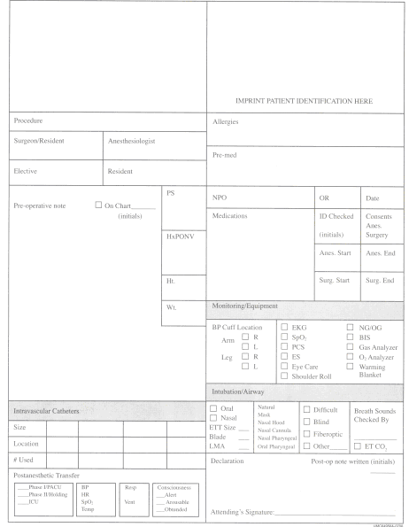
Charting

Slide 28
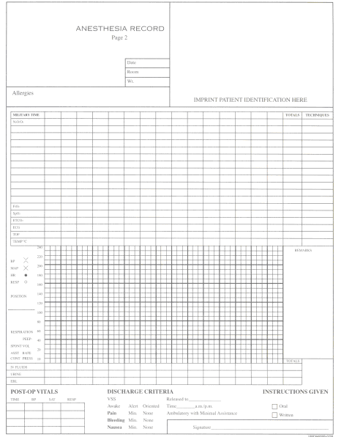
Charting

Slide 29
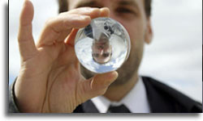
Case Analysis: The Expert Report

Slide 30
Case Analysis 1
33 year old female with “severe dental phobia,” anxiety disorder, smoker
meds: depo provera, multi-vitamin, lexapro, trazodone (insomnia)
Reports for restoration of # 3, 5, 6, 27, 28, 30
Anesthetic plan: halcion and nitrous oxide

Slide 31
Case Analysis 1
Patient received 0.25mg of halcion sublingually one hour prior to arriving for appointment; 0.25 mg of halcion orally just prior to the appointment; 0.25 mg sublingually during administration of care
Nitrous oxide analgesia was provided in conjunction with oral halcion (average of 40%)

Slide 32
Case Analysis 1
Dental procedure was completed without complication
Patient discharged from office 10 minutes following procedure
Patient involved in a motor vehicle accident on the way home
Transport to hospital
Multiple facial fractures
Fractures to arms, leg and hip

Slide 33
Case Analysis 1
Expert Report
Improper & Inappropriate administration of triazolam (Halcion)
Improper & Inappropriate discharge from care

Slide 34
Case Analysis 1
Improper / Inappropriate use of triazolam
The use of triazolam in dentistry is considered off-label
The maximum recommended dose from the FDA / Package insert is 0.5 mg
Previous history of car accidents when triazolam used for insomnia and anxiety reduction in late 1980’s and early 1990’s (Newsweek Article)
Study by Kaufman et al… demonstrated that 0.25 mg of halcion with 30-50% nitrous oxide was just as or more effective as anxiolysis with additional amounts of valium or halcion
Kaufman E, Hargreaves KM, Dionne RA. Comparison of oral triazolam and nitrous oxide with placebo and intravenous diazepam for outpatient premedication. OOO. 1993; 75:156-164.

Slide 35
Case Analysis 1
Improper & Inappropriate discharge from care
General Accepted Guidelines for Discharge
Patient evaluation prior to discharge is the responsibility of a licensed independent practitioner
A responsible adult must accompany any patient who has received other than un-supplemented local anesthesia
Written postoperative and follow up care instructions are provided the patient and responsible adult
A standard discharge criteria is completed prior to the patient leaving the premises of care
Marley RA, Moline BM. Patient discharge from the ambulatory setting. J of Post Anesthesia Nursing. 1996; 11:39-49.
Accreditation Association for Ambulatory Heatlh Care: Anesthesia Services, in 1994/1995 Accreditation Handbook for Ambulatory Health Care. Skokie, IL, 1993. p 40.
American Society of Anesthesiologists: Guidelines for ambulatory surgical facilities, in ASA Standards, Guidelines and Statements. Park Ridge, IL, 1994. p 9.

Slide 36
Case Analysis 1
Standard Aldrete Score Assessment Scale
Two Aldrete Scales (Standard and Modified)
Used to calculate a numerical value that may provide information for patient discharge
Patient’s score must value at the minimum a NINE for discharge
Scale includes assessment evaluation for:
Muscle Activity
Breathing
Consciousness
Circulation
SpO₂

Slide 37
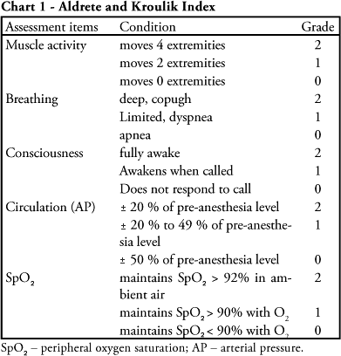
Case Analysis 1

Slide 38
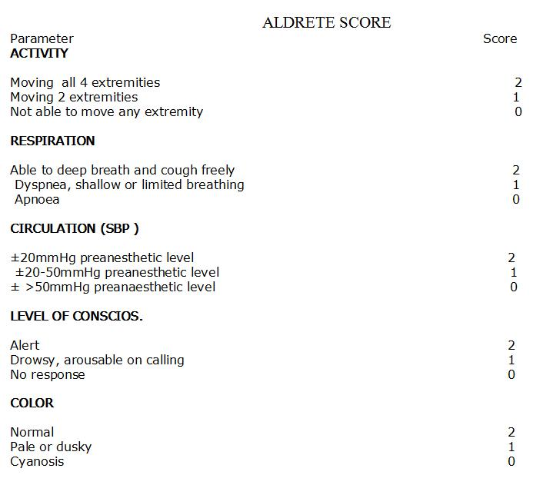
Case Analysis 1

Slide 39
Case Analysis 2
32 year old female; smoker (2 pk / day); sickle-cell anemia trait
Extraction of #18-20 and #30–32; RCT: #29
Developed dry socket following surgery
Litigation with “pain and un-due suffering;” “loss of wages;” “future impact on earnings potential”

Slide 40
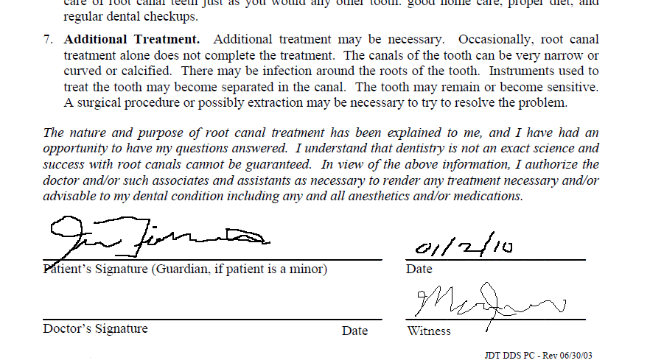
Case Analysis 2

Slide 41
Case Analysis 2
Scheduled for trial
Prior to jury verdict; defendant settled for undisclosed sum
Settlement: Breach of Care – No informed consent
Dentist placed on 12 month probation by dental board and required 50 hours of CE related to consent and medico-legal requirements

Slide 42
Case Analysis 3
62 yo male; 212 lbs; for recall appointment
Dentist’s Med Hx:
HTN; MI (6 Years); Knee Replacement (2 years)
NKA
Smoker (Cessation – 15 years)
“Social Drinker”
Amoxicillin (2 g) Pre-medication (per PCP instruction)

Slide 43
Case Analysis 3
20 minutes into cleaning and exam, patient complains of anxiousness; heart palpitations and “some chest pain”
Office emergency protocol initiated
EMS called by front office personnel
Oxygen and emergency kit obtained by assistant
Dentist and hygienist tends to patient
MONA protocol implemented
EMS arrives
Transfer to hospital (patient dies from MI)

Slide 44
Case Analysis 3
Appropriate Protocol and Successful Transition to Medical Facility
HOWEVER…

Slide 45
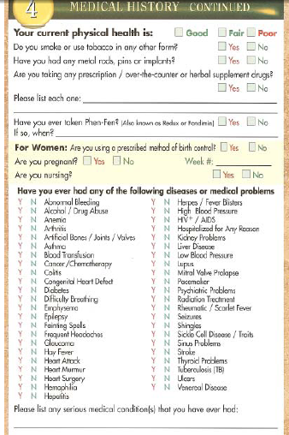
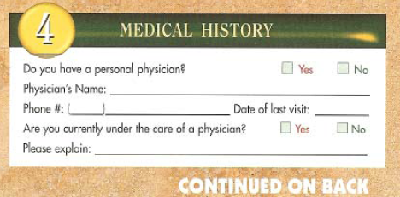
Case Analysis 3

Slide 46
Case Analysis 3 – Standard Dental Code
§ Preparing, maintaining and retaining patient records.
Information with regard to the administration of local anesthesia, nitrous oxide/oxygen analgesia, conscious sedation, deep sedation or general anesthesia. This shall include results of the preanesthesia physical evaluation, medical history and anesthesia procedures utilized.

Slide 47
Case Analysis 3
Physical Evaluation
“As a minimum the physical evaluation should include the following:
Height and weight
Blood Pressure
Resting pulse
Respiration
Hurford WE. Clinical Anesthesia Procedures of the Massachusetts General Hospital, 6 ed. Lippincott Williams & Wilkins. Philadelphia, 2002.

Slide 48
Case Analysis 3
Physical Evaluation
“There are six vital signs: blood pressure, heart rate, respiratory rate, temperature, height, and weight. Vital signs should be recorded on the patient’s dental chart. For a minimum examination, it is recommended that the blood pressure and heart rate and rhythm be monitored for all patients seeking dental care…[as well as weight]”
Malamed SF. Handbook of Local Anesthesia, 5 ed. Elsevier Mosby. Philadelphia, 2004. p 147.

Slide 49
Questions ???

